Slide 1

Final Presentation
December 6, 2021
Notes:
11-11:40

Slide 2
Team member
Shijing Li (Project Manager)
Data Collection/Preprocessing, Visualization
Yangxin Fan
Data Collection, EDA, Modeling
Yuan Wang
EDA, Feature Engineering,
Modeling
Lingyu Ye
Data Collection/Preprocessing, Visualization
2

Slide 3


Agenda
01
02
03
04
Introduction
Data Overview
Modeling
Future Work
3

Slide 4

1. INTRODUCTION

Slide 5
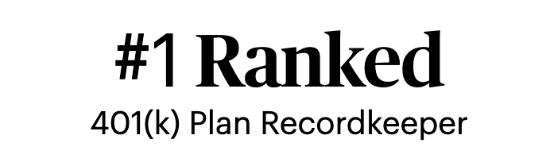
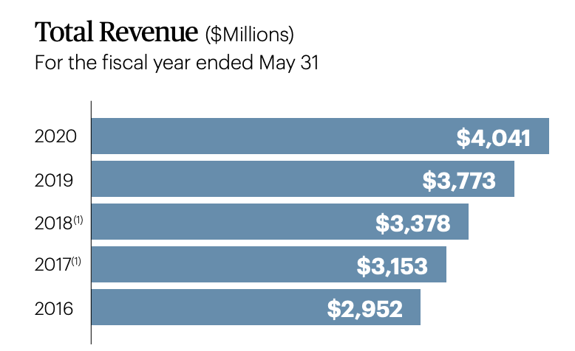
Who is Paychex?
Leading provider of integrated human capital management solutions for payroll, benefits, human resources, and insurance services
680,000 business clients
41% Return on Equity
5
Resource:https://www.paychex.com/
Notes:
Shijing

Slide 6
Goal & Vision
Identify
Identify correlations between Paychex revenue and external features by time
Build
Build various time-series, hybrid, and deep learning-based models to predict Paychex revenue by time
Deliver
Deliver constructive suggestions for Paychex to increase revenue by identifying new "growth"
Goal:
Vision:
Identify the external activities that have a significant impact on Paychex’s internal activity to build prediction models that will forecast Pyachex’s future monthly revenue gain or loss. Produce the best fit model by using performance measurements.
6
Notes:
Shijing
important

Slide 7
Method Overview
EDA, Feature Engineering , Feature Selection
Model
Selection & Tuning
Base Model: SARIMA
Internal Data
Hybrid Model: ThymeBoost
EDA & Preliminary Feature Selection
Final Model (pipeline)
GAM: FB-Prophet
External Data
Deep Learning: LSTM
7
GAM: General Additive Model
Notes:
Shijing

Slide 8
Milestones
Stage 2
Stage 3
Oct.06
Kickoff Meeting with Paychex
Oct.14
Data Acquisition
Oct.16
External Data Hunting
Oct.24
Midterm Presentation
Oct.25
Correlation Analysis
Nov.10
Advanced Models
Nov. 25
Model Comparison and Selection
Oct.29
Preliminary Models
Nov.18
Model Tuning
Dec.6
Final Presentation
Oct.17
Data Cleaning
Oct.22
EDA, Feature Engineering
Stage 1
8
Notes:
Shijing

Slide 9

2. Data Overview

Slide 10
Internal Data
Monthly Revenue Dataset:
Column Name | Description
UNIQUESYSTEMCLIENTID | Client ID
EECOUNT | Employee count
BUSTYPELEVEL1 | Industry type (NAICS2)
STATECODE | State Code
TOTALREV | Total monthly revenue
PRODUCTCOUNT | Total monthly product count
PAYROLLREVENUE | Total monthly revenue in Payroll
PEOREVENUE | Total monthly revenue in PEO
ASOREVENUE | Total monthly revenue in ASO
TIMEREVENUE | Total monthly revenue in Time
RETIREMENTREVENUE | Total monthly revenue in Retirement
HNBREVENUE | Total monthly revenue in Health & Benefit
WRKSCOMPREVENUE | Total monthly revenue in Work Compensation
Dataset Description
FY17-FY21
823,963 rows, 247 columns
(No missing values & duplicates)
Client
Information
Monthly total revenue and product count of all Paychex’s service products
Monthly revenue of 7 different service products
10
Notes:
Lingyu

Slide 11
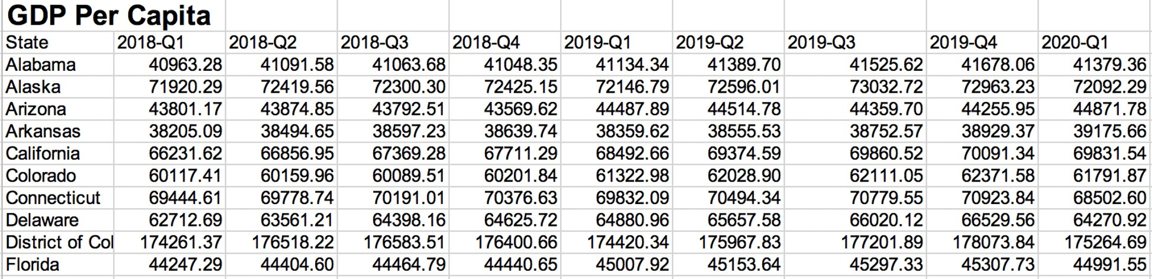



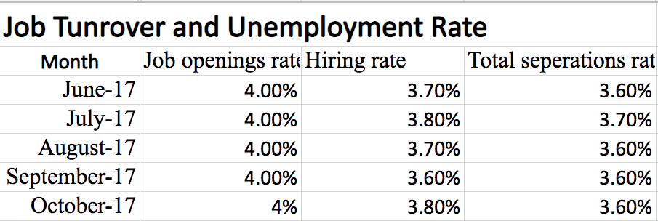
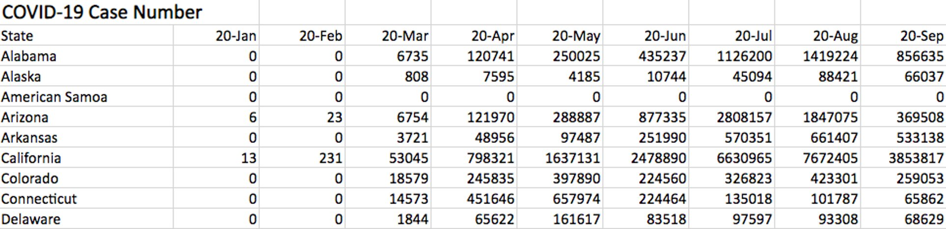
External Data
BUREAU OF ECONOMIC ANALYSIS
U.S. BUREAU OF LABOR STATISTICS
Centers for Disease Control and Prevention
Monthly
- GDP per capita
- Person income per capita
- Inflation rate (quarterly)
Monthly
- Job opening Rate
- Hiring rate
- Separation rate
- Unemployment rate
Monthly
- Case number
- Death number
- Vaccination number
11
Notes:
Below are the list of different factors we brought in. These are decided based on conversation with the client and teamates.
We finally use These datasets after discussion

Slide 12
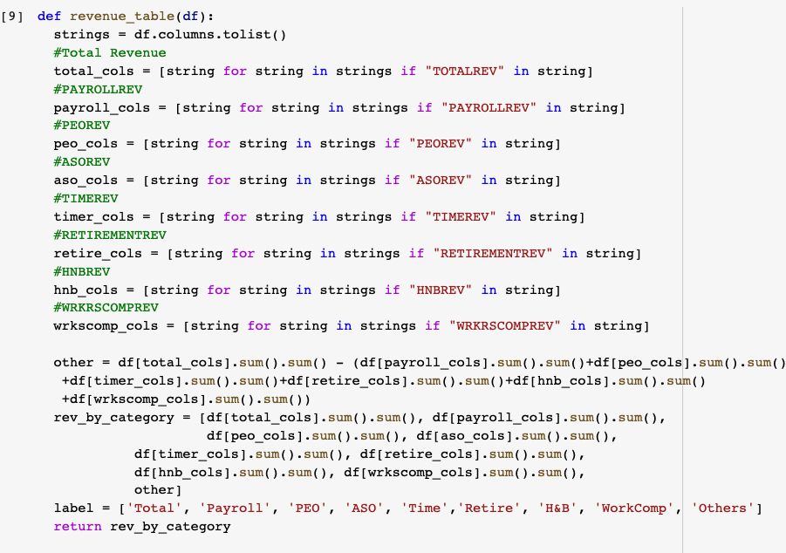
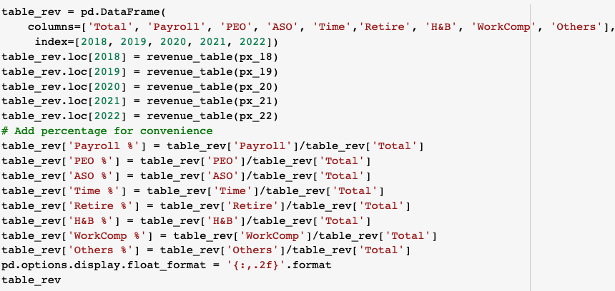
Data Preprocessing
Data cleaning
Check missing and duplicate values
Standardize data granularity
Data transformation
Transform internal & external data to usable formats
Merge internal & external datasets
Data reduction
Aggregate monthly revenue of all industries
Feature selection
12
Notes:
Lingyu
important

Slide 13
Challenges
Limited Internal Datasets (4yrs)
External Datasets
With Different Granularities
No Boundary for External Factors Hunting
Internal Dataset Structured Differently
Notes:
Shijing
Based on handful domain knowledge to test broad range of external factors
Look to explore but limit amount of external data to look for. Had to stop at some point. Work with the ones we have in hand. Other external we didn’t apply that may have impact. (contains bias)

Slide 14
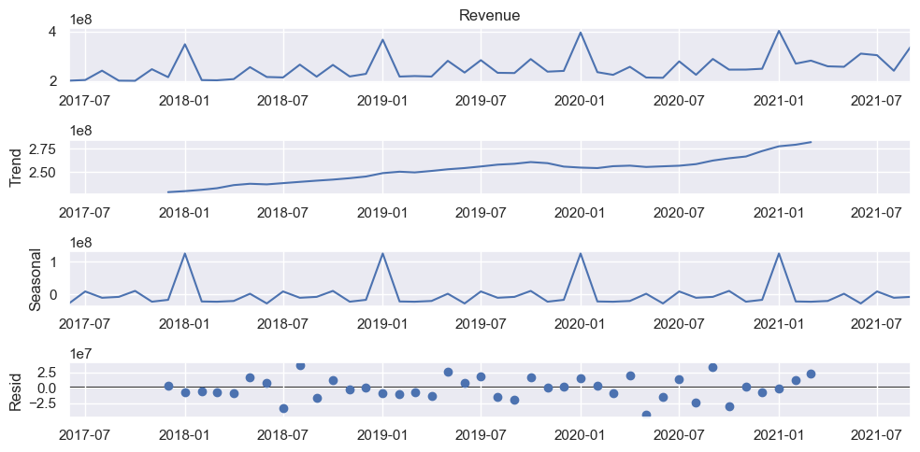
Exploratory Data Analysis – Data Decomposition
14
Notes:
Lingyu: decompose, trend. Slightly increase, seasonality. For time series, We need residual, no pattern with is desirable.

Slide 15
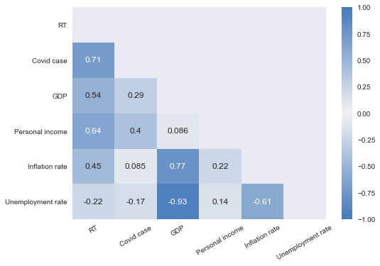
Exploratory Data Analysis – Covid Correlation Analysis
Correlation between RT (residual + trend) Seasonally Adjusted Revenue, COVID-19 and Econimic external factors
Quarterly data from 2020 Q1 to 2021 Q3
Conclusion: GDP & Inflation Rate are highly correlated with Seasonality Adjusted Revenue.
(r = 0.81)
Notes:
Lingyu during the covid time, want to see the correlation for external factors under the covid, and see how them effect total revenue.
Our initial Corr Analysis done during COVID → understand how COVID impact revenue

Slide 16
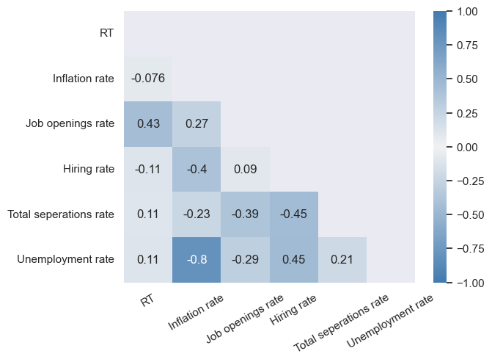
Exploratory Data Analysis – Correlation Analysis
Correlation between RT (residual + trend) Seasonally Adjusted Revenue and BLS external factors
Monthly data from 06/2017 - 08/2021
Conclusion: Job Opening Rate is moderately correlated with Seasonality Adjusted Revenue (r = 0.43)
Notes:
Yangxin
Not only covid-19, but also extend …. All data

Slide 17
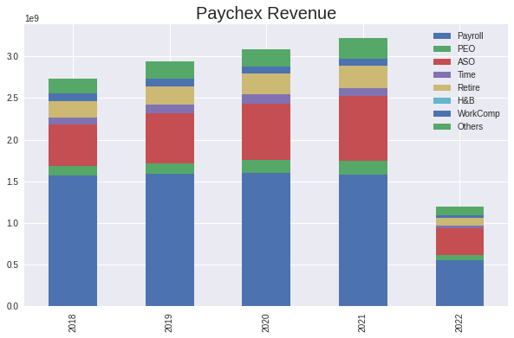
EDA – Data Visualization
PEO: Professional Employer Organization
ASO: Administrative Services Organization
H&B: Health & Benefits
5%
5%
5%
8%
9%
4%
8%
7%
The total revenue is increasing over the years.
The revenue percentage for the Payroll service product is decreasing.
The revenue percentage for the ASO service product is increasing.
20%
22%
24%
18%
57%
54%
52%
49%
27%
46%
2018 2019 2020 2021 2022
17
* 2022 fiscal year is incomplete (3 months data), but the trend of each portion stays consistent.
Notes:
Yuan

Slide 18
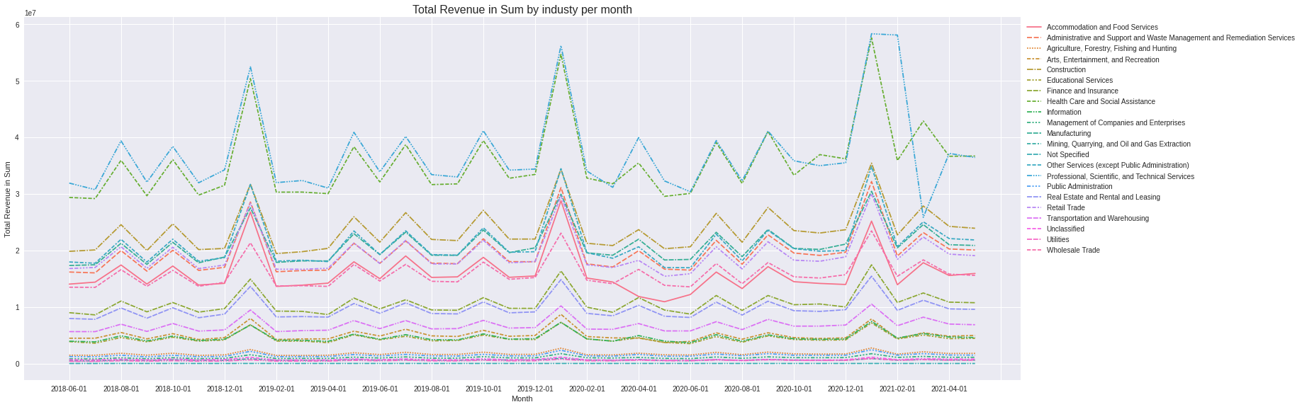
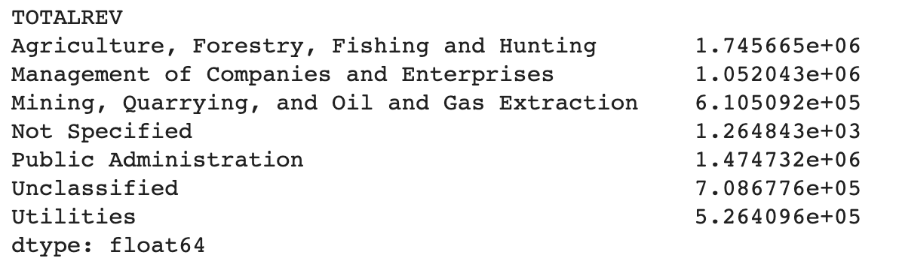
EDA – Data Visualization
Over the years, there is no significant change in revenue contribution among different industries.
We can use Total Revenue instead of each industry for the future revenue prediction.
18
Notes:
Yuan
no significant change in revenue contribution
The revenue trend of all industries are same, so we take total revenue for the prediction
Mention top 3 industry

Slide 19
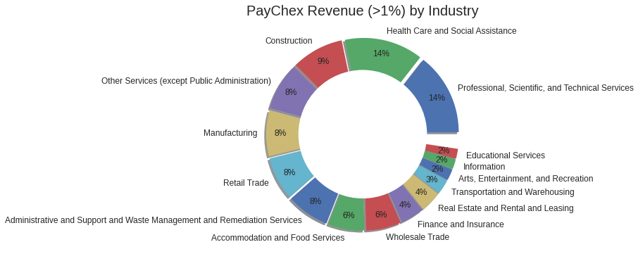
EDA – Data Visualization
The top-3 industries are Professional services, Health care, and Construction.
One trillion infrastructure bill passed will lead a high potential opportunity in construction industry.
19
Notes:
Yuan
no significant change in revenue contribution
The revenue trend of all industries are same, so we take total revenue for the prediction
Mention top 3 industry

Slide 20
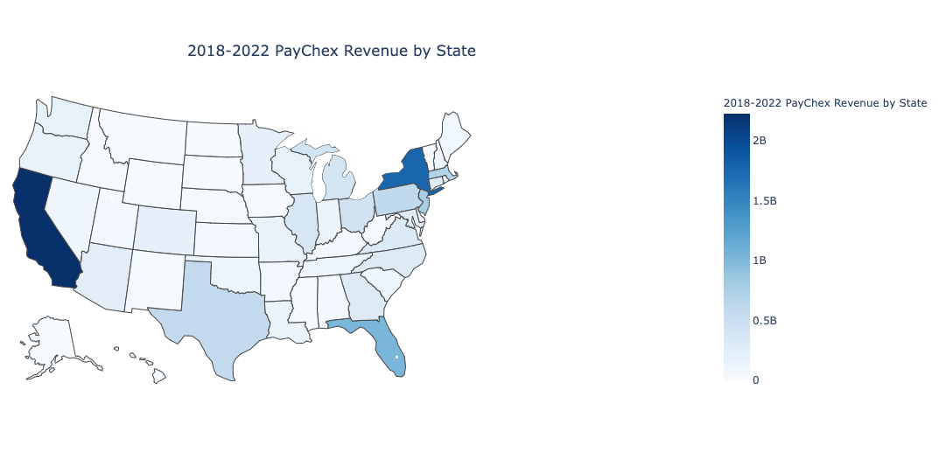
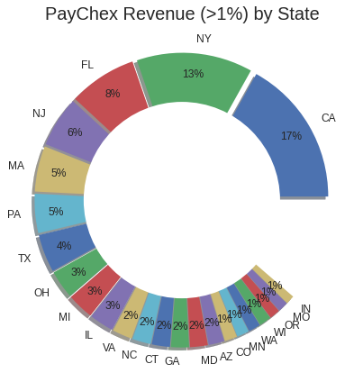
EDA – Data Visualization
2018-2022 Paychex Revenue by State
2018-2022 Paychex Revenue by State
2B
1.5B
1B
0.5B
0
Top-5 states with the highest revenue: CA, NY, FL, NJ, and MA
TX, IL have large potential to obtain more revenue since they are 2nd and 5th largest economy state in the U.S.
20
Notes:
Yuan

Slide 21

3. Modeling

Slide 22
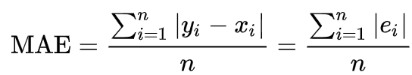

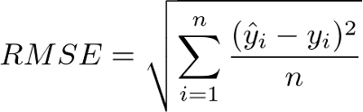
Performance Measurement
MAE: Mean absolute error (MAE) is the average of the absolute errors.
MAPE: Mean absolute percentage error (MAPE) is a measure of prediction accuracy of a forecasting method in statistics.
RMSE: Root Mean Square Error (RMSE) is the standard deviation of the errors/residuals.
Testing period: 12/2020 to 08/2021
22
Notes:
Yangxin - important
Introduce overall definition of 3 measurements
MAPE is the final choice, more intuitive (explanation: intuitive interpretation in terms of relative error.)
Mention the testing period

Slide 23

Model - SARIMA
$$SARIMA {(p,d,q)×(P,D,Q)}_{lag}$$
Non-seasonal part (p, d, q)
Seasonal part (P, D, Q)
Lag
ARIMA model for non-seasonal part
ARIMA model for seasonal part (backshifts of seasonal period)
Seasonal period Lag = 12 (monthly revenue)
(p, d, q) (P, D, Q) are integers $≥0$ and refer to the order of the autoregressive, integrated, and moving average of the model respectively
23
Notes:
Yangxin
Introduce 3 components of the model
Talk abour p,d,q, P,D,Q

Slide 24
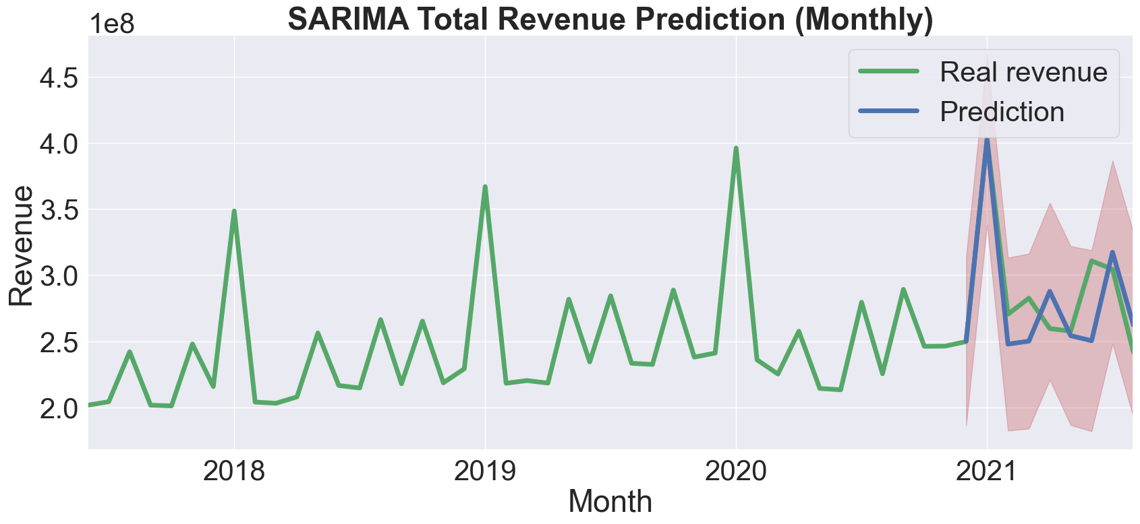
Model - SARIMA
Test MAPE | 0.08 (8.0%)
Test MAE | $22.28 million
Test RMSE | $28.71 million
External feature used: Job openings rate (correlated with seasonally adjusted revenue)
Final model chosen by AIC cost: $SARIMA {(0, 1, 1)×(1, 1, 1)}_{12}$ + Job Openings Rate
24
Notes:
Yangxin
Definition of each color line(component)
What external features are used
How the model is chosen
Final performance measurements

Slide 25
Model - LSTM
Min-Max normalization of revenue and external factors
Training samples (look back period = 12 months)
Input layer
Look back period (12 months)
June 2018
Nov 2020
Aug 2021
LSTM layer 1
LSTM layer 2
Trained by MAE
June 2017
Training period
Testing period
Dense layer
Training period: 06/2018 - 11/2020 (30 months)
Testing period: 12/2020 - 08/2021 (9 months)
Output layer (predicted revenue)
Prediction (denormalization)
25
Notes:
Yangxin
Two LSTM layers + trained by MAE
Look back period 12 months → only 30 months data for training -> fewer training data than other models
2 layers+ dense layer
Trainning+testing timeline

Slide 26
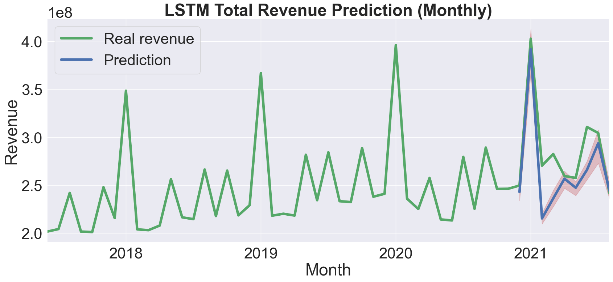
Model - LSTM
Test MAPE | 0.074 (7.4%)
Test MAE | $21.12 million
Test RMSE | $29.00 million
No external features since including external features worsens model performance
Ensembled LSTM model (100 LSTM models)
26
Notes:
Yangxin
Noise -> No external
Large var in single model -> ensemble learner

Slide 27
Model - ThymeBoost
TS Data
De-Trend
De-Seasonality
Set y = residuals
Traditional time series decomposition for trend, seasonality
Gradient boost model for residual
Cost minimize
Control for exogenous
Cost minimized ?
Aggregate all rounds
27
Notes:
Yuan

Slide 28
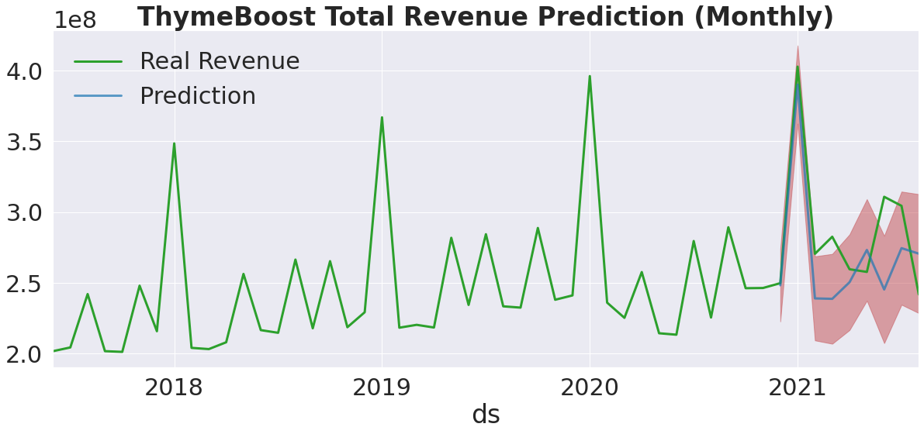
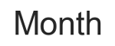
Model - ThymeBoost
Test MAPE | 0.09 (9.0%)
Test MAE | $25.73 million
Test RMSE | $31.81 million
No external features
Trend estimator: Linear
Seasonal estimator: Fourier
Cost: AIC
28
Notes:
Yuan

Slide 29
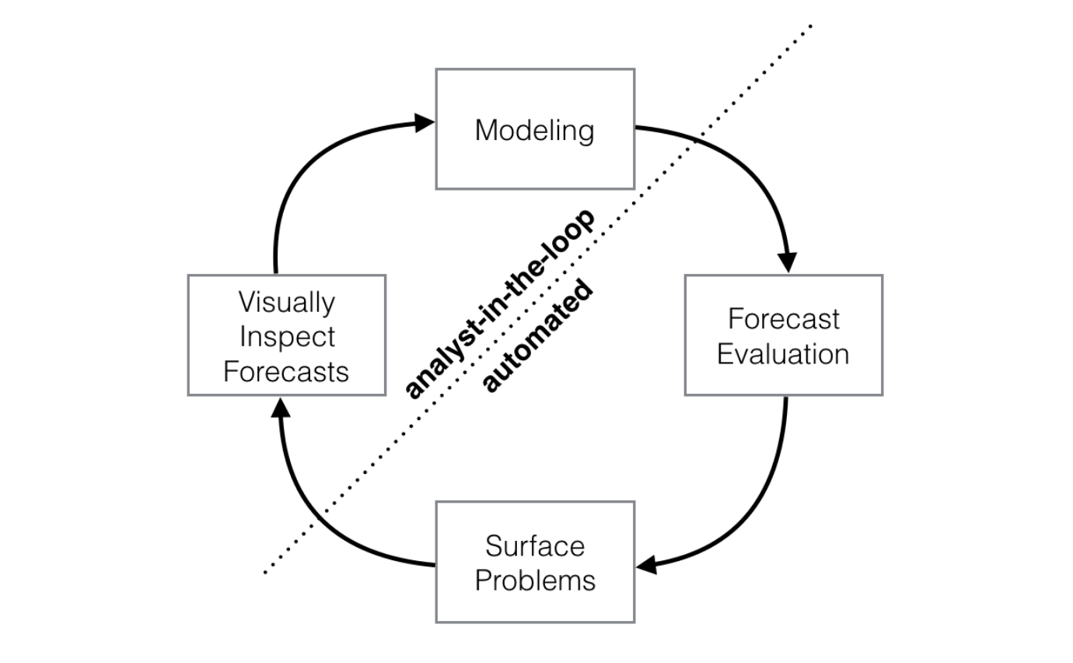
Model – FB-Prophet
y(t) = g(t) + s(t) + h(t) + e(t)
g(t) is a trend function which models the non-periodic changes.
s(t) represents a periodic changes
h(t) is a function that represents the effect of holidays which occur on irregular schedules.(n≥1 days)
e(t) represents error changes that are not accommodated by the model.
29
https://peerj.com/preprints/3190.pdf#section.1
Notes:
Yuan

Slide 30
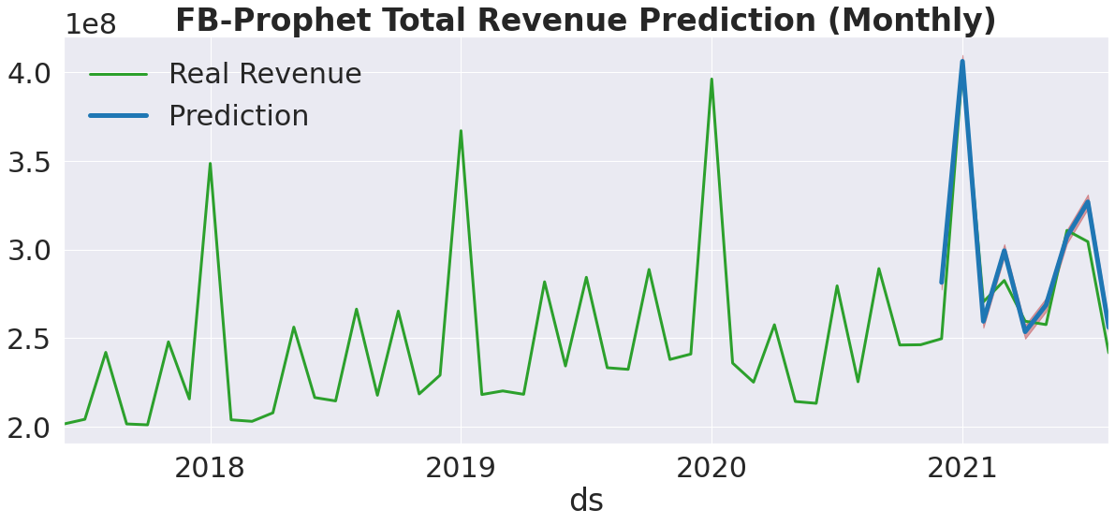
Model – FB-Prophet + peak indication
Test MAPE | 0.049 (4.9%)
Test MAE | $13.33 million
Test RMSE | $15.98 million
External features used : Job Openings Rate, Hiring Rate, Total Separations Rate, Unemployment Rate, Inflation Rate
Holidays/Peak events indication applied both on train and test periods
30
Notes:
Yuan

Slide 31
Model Comparison
MODEL | Inputs | MAPE | Threshold | Interpretation
FB-Prophet | TS data, external features | 4.9% | <5% | Highly Accurate
LSTM | TS data | 7.4% | <10% | Good
SARIMA | TS data, external features | 8.0% | <10% | Good
ThymeBoost | TS data | 9.0% | <10% | Good
31
Notes:
Yangxin - imporant
All models are good < 10%
Best model – FB highly accurate < 5%
LSTM high potential with more data
Model inputs + result compare
-pros and cons
-highlight the best
Add benchmark
Adjust the sequence the model performance
<5
5-10
>20
Talk about the business feedback from Paychex
Based on business feedback from Paychex, < 5% MAPE is promising.
MAPE of every model < 10% shows good performance despite of limited data.

Slide 32

Conclusion
The increase in GDP, Inflation rate and, Job opening rate may indicate an increase in Paychex revenue
FB-Prophet has the best performance with 4.9% of MAPE
Potential revenue growth opportunities in Texas and Illinois. (enhance marketing activities)
Potential opportunities in construction industry
32
Notes:
important
Model inputs + result compare
Data
Model
Suggestions

Slide 33

4. Future Work

Slide 34
Future works
01
Future Revenue Data
LSTM (Deep Learning)
02
Future Marketing Peaks
FB-Prophet
Client Data (EEcount etc.)
Prediction Model
03
34
Notes:
Shijing - important
By keep adding revenue data as time goes to better fit deep learning-based models like LSTM to produce better result
future marketing (budget) peaks into FB-prophet model to boost performance
Capture monthly EEcount time-series data of each client and include it as a feature in prediction model

Slide 35


Acknowledgement
Paychex Client
Ryan Hayden
Joel Page
Oseoba Airewele
Mike Childress
Advising Professor
Prof. Cantay Caliskan
Prof. Ajay Anand
Notes:
Shijing

Slide 36

Thanks!
36

Slide 37
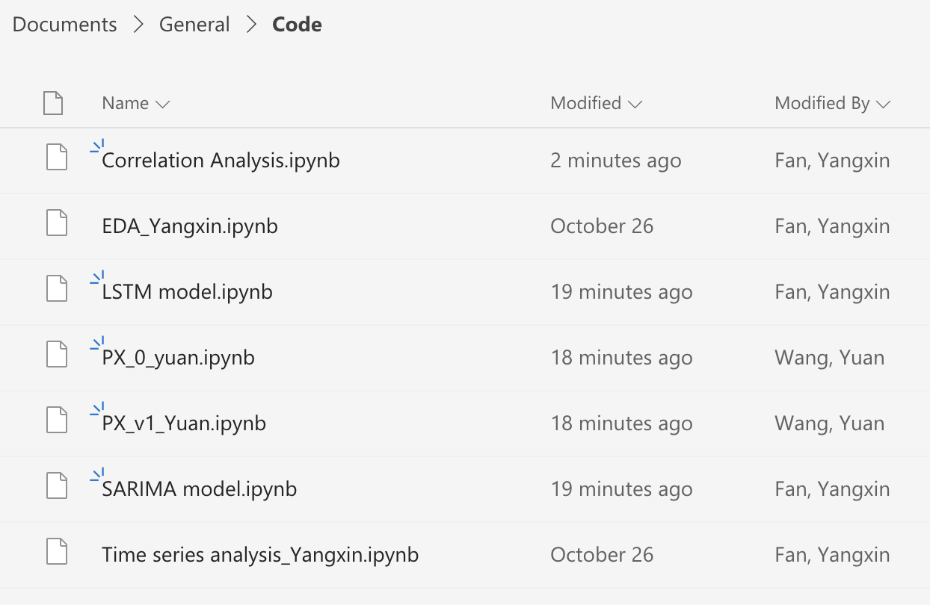
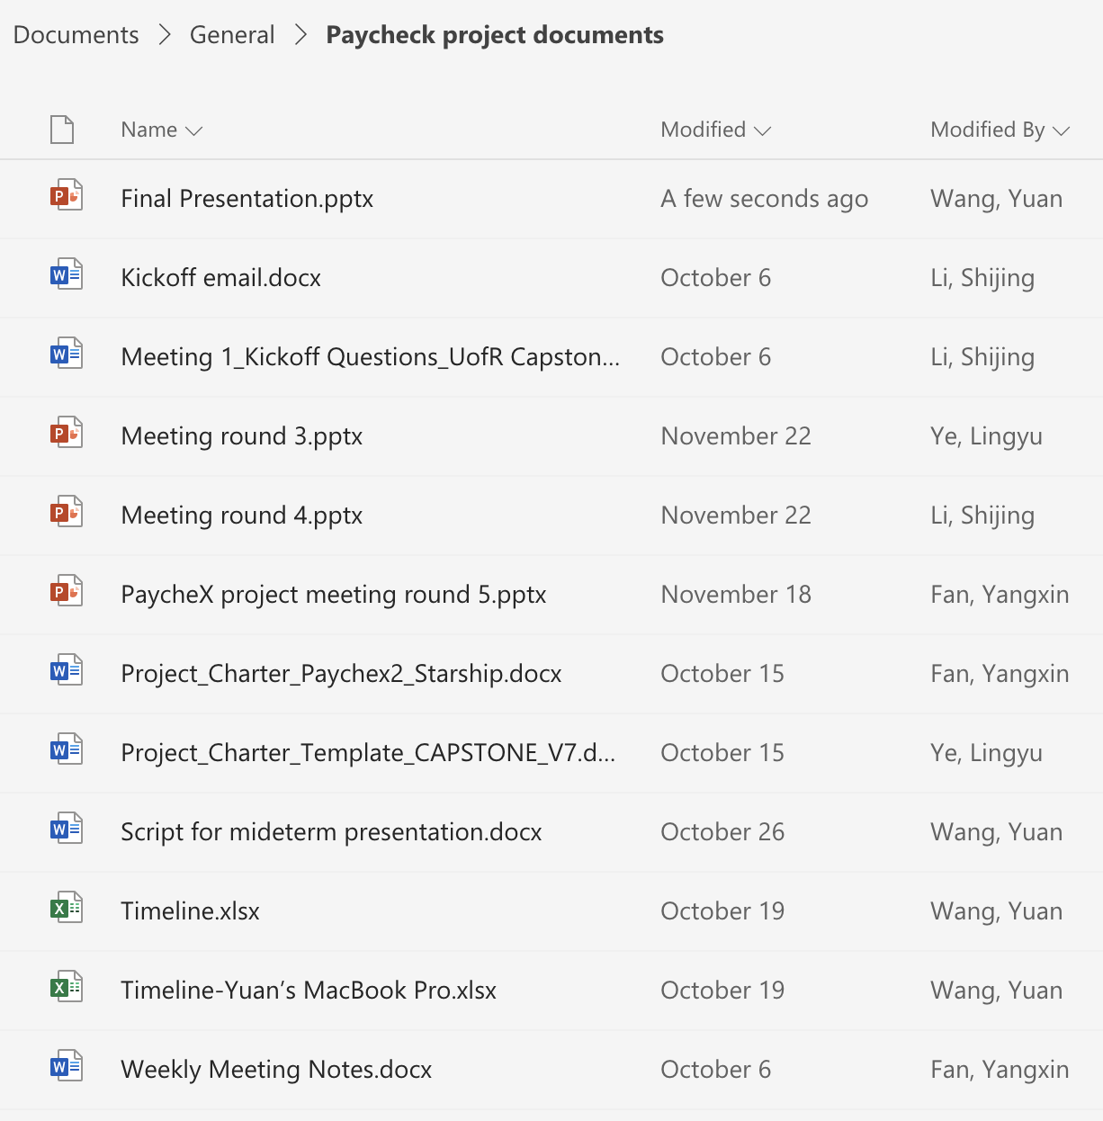
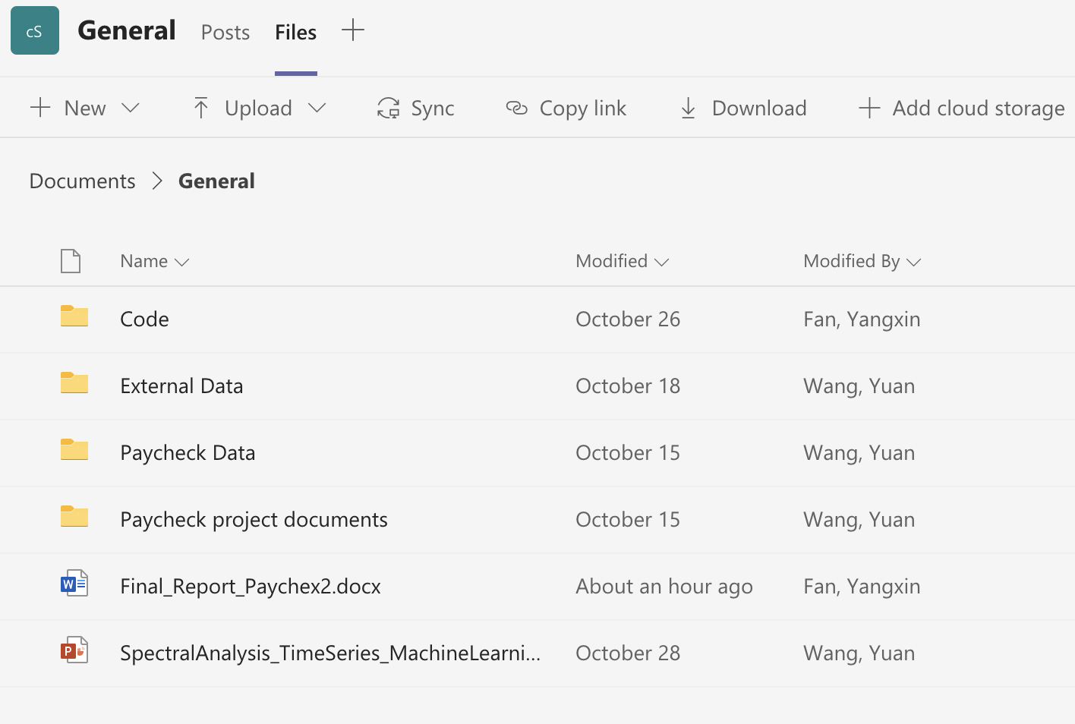
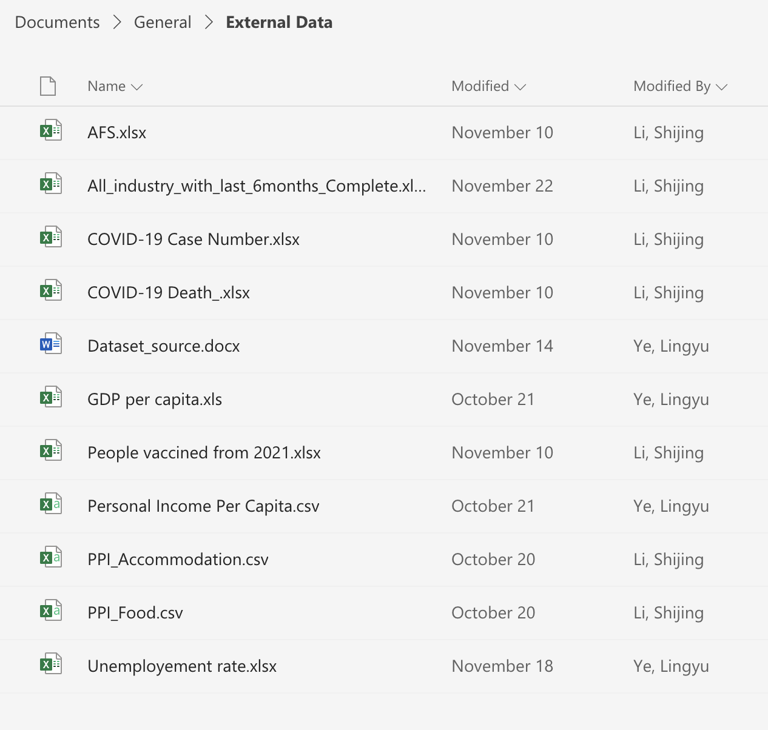
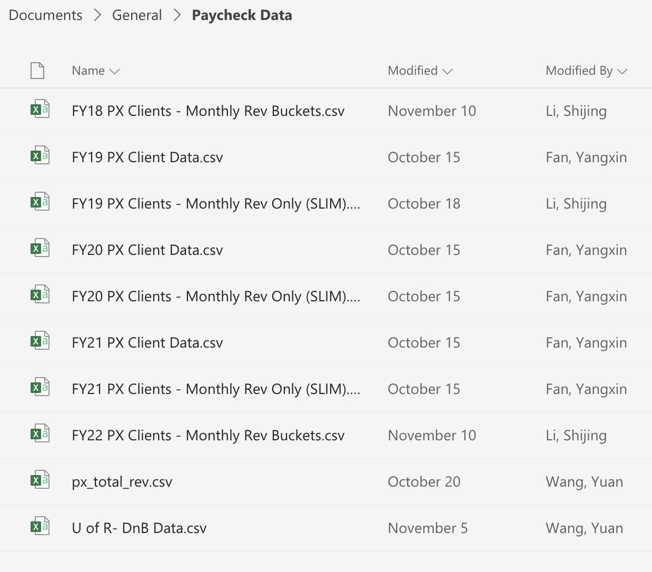
Appendix – Project Directory
Notes:
Shijing

